Slide 1
Recursive Thinking 101
Mr. Channa Bankapur

Slide 2
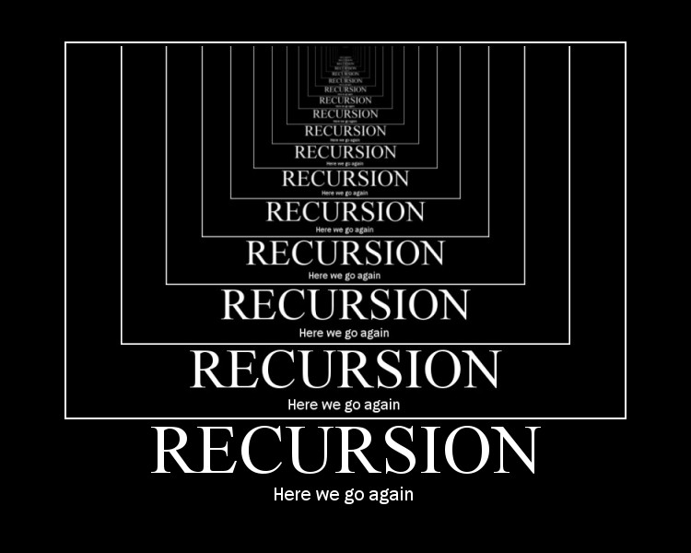
Recursion: defining a problem in terms of itself!

Slide 3
Recursive Thinking
is an
Algorithmic Thinking
which is a
Computational Thinking
Mr. Channa Bankapur

Slide 4
Problem:
Search for an element in an array of elements.
Let A[0 .. n-1] be the array and key be the element to search for.
Idea: Transform the search problem to a smaller instance of the search problem and solve recursively.
This is the beginning of thinking recursively!

Slide 5
Search by recursion (Transform-and-Conquer)
// call search(A, 0, n-1, key) for an array A[0 .. n-1]
// returns the offset of the first occurence of the key in A
Algorithm search(A, low, hi, key)
if(hi-low+1 = 0) return -1
if(A[low] = key) return low
return search(A, low + 1, hi, key)

Slide 6
Tail recursion is a special kind of recursion where the recursive call is the very last thing in the function.
Tail recursion is a kind of transform-and-conquer. The problem is transformed to a smaller instance of the same problem.
The result of the recursive call can be passed directly to the original caller instead of waiting for it. You can reuse stack frame.
Some programming languages (compiler) optimize tail recursion.
We can always manually convert a tail recursion to iterative.
Algorithm search(A, low, hi, key)
if(hi-low+1 = 0) return -1
if(A[low] = key) return low
return search(A, low + 1, hi, key)

Slide 7
Convert
tail recursive algorithm
to
iterative algorithm
This is the
Sequential Search algorithm
Algorithm search(A, low, hi, key)
if(hi-low+1 = 0) return -1
if(A[low]=key) return low
return search(A, low + 1, hi, key)
Algorithm search(A, low, hi, key)
LOOP: if(hi-low+1=0) return -1
if(A[low] = key) return low
low = low + 1
goto LOOP
Algorithm search(A, low, hi, key)
while(NOT(hi-low+1 = 0))
if(A[low]=key) return low
low = low + 1
return -1
Algorithm search(A, low, hi, key)
for i = low to hi-1
if(A[i] = key) return i
return -1

Slide 8
Convert
tail recursive algorithm
to
iterative algorithm
This is the
Sequential Search algorithm
Algorithm search(A, low, hi, key)
if(hi-low+1 = 0) return -1
if(A[hi]=key) return hi
return search(A, low, hi-1, key)
Algorithm search(A, low, hi, key)
LOOP: if(hi-low+1=0) return -1
if(A[hi] = key) return hi
hi = hi - 1
goto LOOP
Algorithm search(A, low, hi, key)
while(NOT(hi-low+1 = 0))
if(A[hi]=key) return hi
hi = hi - 1
return -1
Algorithm search(A, low, hi, key)
for i = hi-1 downto low
if(A[i] = key) return i
return -1

Slide 9
Search for key in A[0..n-1].
Call search(A, n, key)
Convert
tail recursive algorithm
to
iterative algorithm
This is the
Sequential Search algorithm
Algorithm search(A, n, key)
if(n = 0) return -1
if(A[n-1]=key) return n-1
return search(A, n-1, key)
Algorithm search(A, n, key)
LOOP: if(n = 0) return -1
if(A[n-1] = key) return n-1
n = n - 1
goto LOOP
Algorithm search(A, n, key)
while(NOT(n = 0))
if(A[n-1] = key) return n-1
n = n - 1
return -1
Algorithm search(A, n, key)
for i = n-1 downto 0
if(A[i] = key) return i
return -1

Slide 10
Compare these algorithms.
Algorithm search1(A, n, key)// f(n)
if(n = 0) return -1
if(A[n-1]=key) return n-1
return search1(A, n-1, key)// f(n-1)
Algorithm search2(A[], n, key)
if n = 0 return -1
if(A[0] = key) return 0
ans = search2(A[] + 1, n-1, key)
if(ans == -1) return ans
else return 1 + ans

Slide 11
Convert
almost-tail-recursive algorithm
to
tail-recursive algorithm
Algorithm search2(A[], n, key)
if n = 0 return -1
if(A[0] = key) return 0
return 1 + search(A[] + 1, n-1, key)
Algorithm search(A[], n, key)
searchAux(A[], n, key, 0)
Algorithm searchAux(A[], n, key, offset)
if n = 0 return -1
if(A[0] = key) return offset
return searchAux(A[]+1, n-1, key, offset+1)

Slide 12
Problem:
Reverse a string of length n in-place.

Slide 13
Problem:
Come up with an in-place sorting algorithm by transforming the problem to a smaller instance of the problem.
Hint: Use the following method to find the largest element.
maxIndex = findMaxIndex(A[], n)

Slide 14
Recursive sorting algorithm
Algorithm sort( A[], n )
if(n <= 1) return
maxIndex = findMaxIndex(A[], n)
swap(A[n-1], A[maxIndex])
sort(A[], n-1)
Is it tail recursive?
Do we have a name for this sorting algorithm?

Slide 15
Convert
tail recursive algorithm
to
iterative algorithm
This is the
Selection Sort algorithm
Algorithm sort( A[], n )
if(n <= 1) return
maxIndex = findMaxIndex(A[], n)
swap(A[n-1], A[maxIndex])
sort(A[], n-1)
Algorithm selectionsort(A[], n)
LOOP: if(n <= 1) return
maxIndex = findMaxIndex(A[], n)
swap(A[n-1], A[maxIndex])
n = n-1, goto LOOP
Algorithm selectionsort(A[], n)
while(NOT(n <= 1))
maxIndex = findMaxIndex(A[], n)
swap(A[n-1], A[maxIndex])
n = n-1
Algorithm selectionsort(A[], n)
for i = n downto 2
maxIndex = findMaxIndex(A[], i)
swap(A[i-1], A[maxIndex])

Slide 16
Another recursive sorting algorithm
Algorithm sort(A[], n)
if(n <= 1) return
// Keep straightening the consecutive pairs from left to right
for i = 0 to n-2
if(A[i] > A[i+1]) swap(A[i], A[i+1])
sort(A[], n-1)
Is it tail recursive?
Do we have a name for this sorting algorithm?

Slide 17
Convert
tail recursive algorithm
to
iterative algorithm
This is the
Bubble Sort
algorithm
Algorithm sort( A[], n )
if(n <= 1) return
for i = 0 to n-2
if(A[i] > A[i+1]) swap(A[i],A[i+1])
sort(A[], n-1)
Algorithm sort(A[], n)
LOOP: if(n <= 1) return
for i = 0 to n-2
if(A[i] > A[i+1]) swap(A[i],A[i+1])
n = n-1, goto LOOP
Algorithm sort(A[], n)
while(NOT(n <= 1))
for i = 0 to n-2
if(A[i] > A[i+1]) swap(A[i],A[i+1])
n = n-1
Algorithm sort(A[], n)
for k = n downto 2
for i = 0 to k-2
if(A[i] > A[i+1]) swap(A[i],A[i+1])

Slide 18
Tail Recursion template
Algorithm solve( problem )
if(base case)
solve the base case and return
do some core work
so the problem gets smaller
return solve(the smaller problem)

Slide 19
Yet another recursive sorting algorithm
Algorithm sort(A[], n)
if(n <= 1) return
sort(A[], n-1) //sort A[0..n-2]
// We have n-1 sorted elements. Now, make it n.
Is it tail recursive?
Do we have a name for this kind of recursion?
Do we have a name this particular sorting algorithm?

Slide 20
Head Recursive sorting algorithm
Algorithm sort(A[], n)
if(n <= 1) return
sort(A[], n-1) //sort A[0..n-2]
// insert A[n-1] into sorted A[0 .. n-2]
val = A[n-1]
i = n-1
while(i > 0 AND A[i-1] > val)
A[i] = A[i-1]
i = i-1
A[i] = val

Slide 21
Head Recursion template
Algorithm solve( problem )
if(base case)
solve the base case and return
result = solve(the smaller problem)
Extend the result of the subproblem
so that it is the result of the problem
return result

Slide 22
Convert
head recursive algorithm
to
iterative algorithm
This is the
Insertion Sort
algorithm
// top-down
Algorithm sort(A[], n)
if(n <= 1) return
sort(A[], n-1)
val = A[n-1], i = n-1
while(i > 0 AND A[i-1] > val)
A[i] = A[i-1], i = i-1
A[i] = val
// bottom-up
Algorithm sort(A[], n)
for size = 2 to n
val = A[size-1], hole = size-1
while(hole > 0 AND A[hole-1] > val)
A[hole] = A[hole-1], hole--
A[hole] = val

Slide 23
Head recursion is a kind of decrease-and-conquer. The solution to a smaller instance of the problem is used to solve the problem.
Head recursion is typically elegant and straight from math induction (or strong induction)
To solve f(n), assume you know the solution for f(n-1). Extend the solution of f(n-1) to solve for f(n).
The process of manually converting a head recursion to iterative is also known as converting a top-down algorithm to its bottom-up version.
Naïve implementation could suffer from stack depth and sometimes overlapping subproblems. The stack depth leads to a poorer space efficiency and the “process” may crash because of stack overflow. Also, recursion (function calls) has added overhead. So converting head recursion into a bottom-up iterative implementation is common.

Slide 24
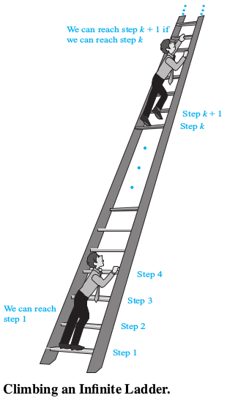
Mathematical Induction
Suppose that we have an infinite ladder and we want to know whether we can reach every step on this ladder. We know two things:
We can reach the first step of the ladder.
If we can reach a particular step of the ladder, then we can reach the next step.
By math induction, we can conclude that we can reach every step from the step 1 onwards.

Slide 25
Principle of Mathematical Induction:
To prove that predicate P(n) is true for all positive integers n we complete two steps:
Basis Step: We verify that P (1) is true.
Inductive Step: We show that the conditional statement P(k)→P(k+1) is true for all positive integers k ≥ 1.
That is, ( P(1) ∧ ∀k (P(k) → P(k+1)) ) → ∀n P(n) is a tautology.
Proof: Using well-ordering principle.

Slide 26
Let S be a finite set with n elements, where n is a nonnegative integer. Without loss of generality, let S = {1, 2, …, n}.
Problem: Use mathematical induction to show that S = {1, 2, …, n} has 2^{n} subsets.
Problem: Using the above proof, design an algorithm to find the power set of a set S = {1, 2, …, n}.

Slide 27
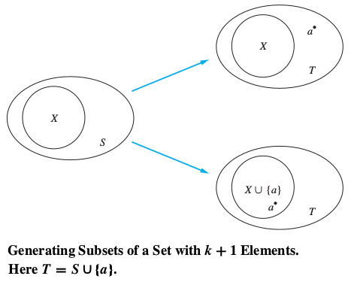
Proof:
Basis step: P(0) = 1 = 2⁰.
Suppose P(k) is true. That is, there are 2^{k} subsets of {1, 2, …, k}.
All the 2^{k} subsets of {1,2,…,k} are also subsets of {1,2,…,k,k+1}. None of them has the element k+1 in them. Another set of 2^{k} subsets of can be formed by adding element k+1 to each them.
hence there are 2^{k+1} subsets of {1,2,…,k,k+1}. That is, P(k+1) is true.
Therefore, any set S with n elements has 2^{n} subsets.

Slide 28
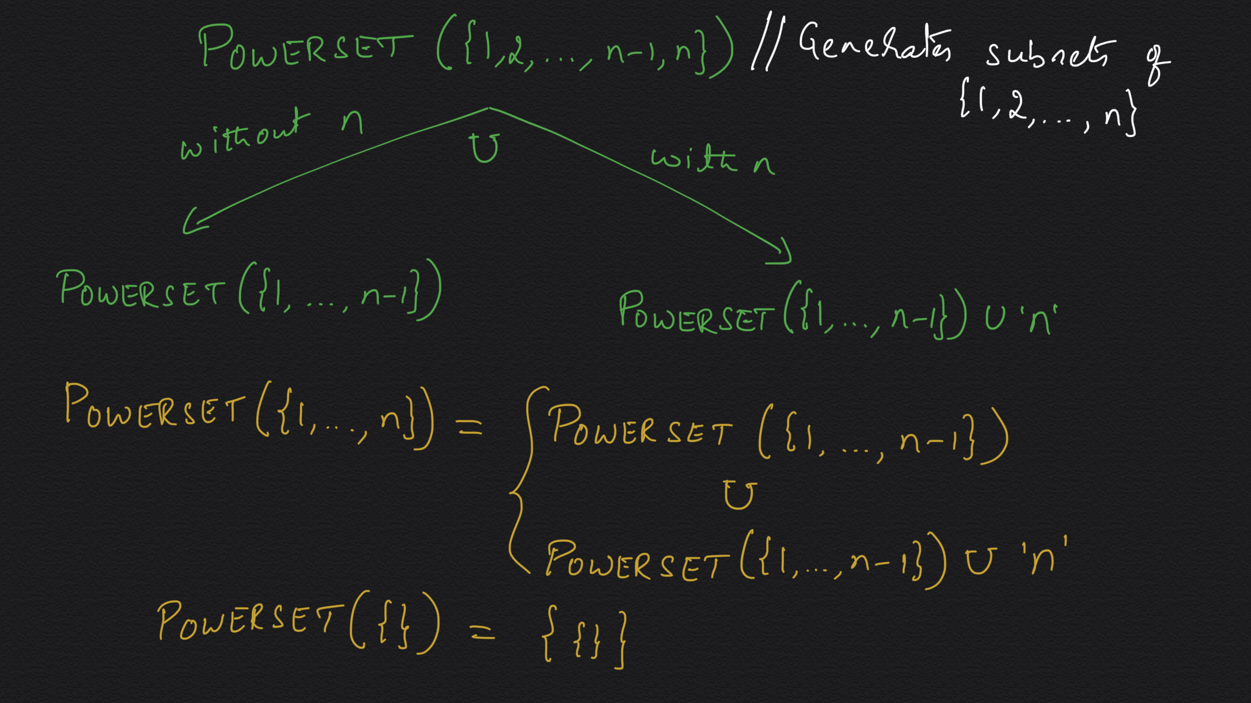

Slide 29
Generate the power set of {1, 2, …, n}
Algorithm powerset({1,2,…,n})
if(n = 0) return {ɸ}
s₁ = powerset({1,2,…,n-1})
s₂ = {}
for each element e in s₁
e₂ = union(e, {‘n’})
s₂ = union(s₂, e₂)
return union(s₁, s₂)

Slide 30
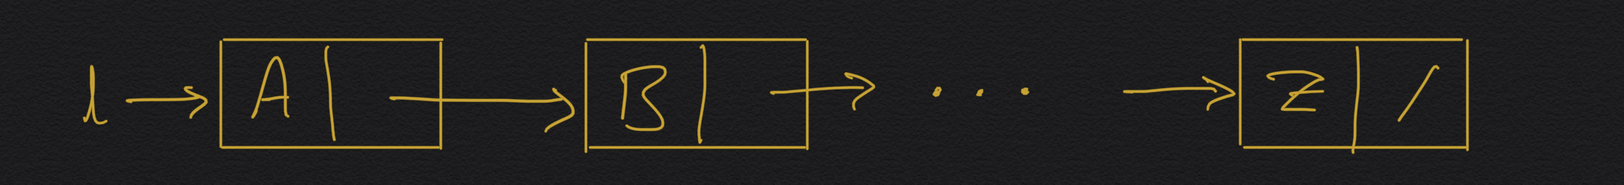
Problem:
Sort a linked list.

Slide 31
Problem:
Reverse a linked list.

Slide 32
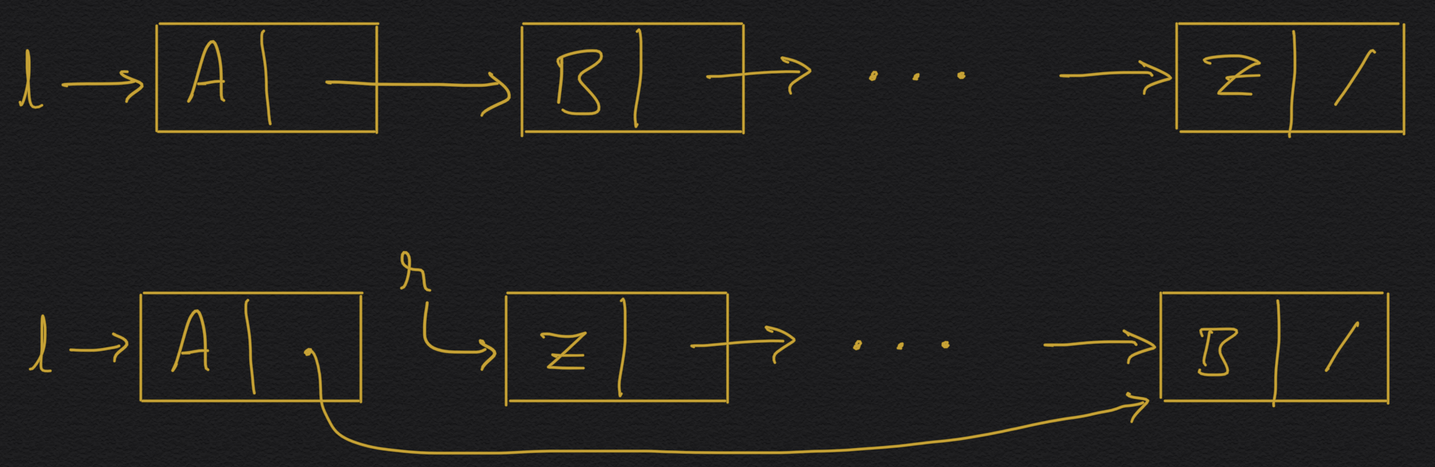
Reverse a linked list, recursively
Algorithm Reverse(list) // f(n)
… // base case
r = Reverse(list.next) // f(n-1)
… // extend f(n-1) to f(n)
return <reversed list>

Slide 33
Reverse a linked list, recursively
Algorithm Reverse(list)
if(list = null) return list
if(list.next = null) return list
r = Reverse(list.next)
tail = getTail(r) // O(n) procedure
tail.next = list
list.next = null
return r
T(n) = T(n-1)+cn = O(n²)

Slide 34
Reverse a linked list, recursively
Algorithm Reverse(list)
<head, tail> = RevAux(list)
return head
Algorithm RevAux(list)
if(list = null) return <list,list>
if(list.next = null) return <list,list>
<r,tail> = RevAux(list.next)
tail.next = list
list.next = null
return <r,list>
T(n) = T(n-1) + 1 = O(n)

Slide 35
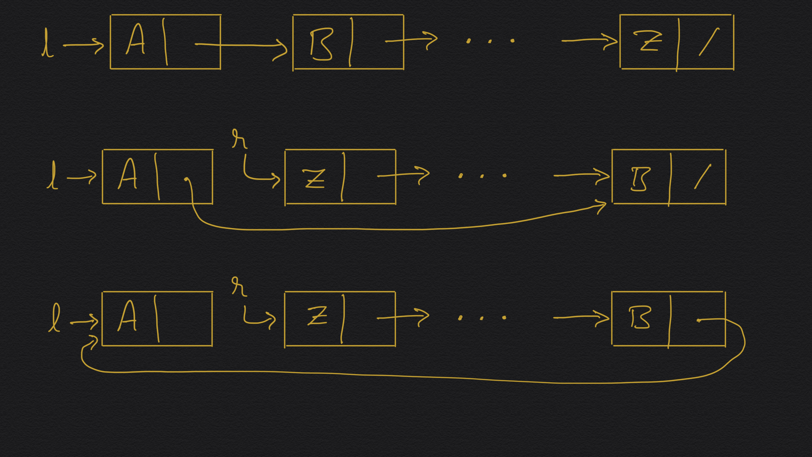

Slide 36
Reverse a linked list, recursively
Algorithm Reverse(list) // f(n), f(1..n)
if(list = null) return list
if(list.next = null) return list
r = Reverse(list.next) // f(n-1), f(2..n)
(list.next).next = list
list.next = null
return r
T(n) = T(n-1) + 1 = O(n).
S(n) = O(n).

Slide 37
Reverse a linked list, bottom-up
Algorithm Reverse(list)
if(list = null OR list.next = null) return list
reversed = list, cur = list.next
reversed.next = null
while(cur != null)
nxt = cur.next
cur.next = reversed
reversed = cur, cur = nxt
return reversed
T(n) = O(n). S(n) = O(1).

Slide 38
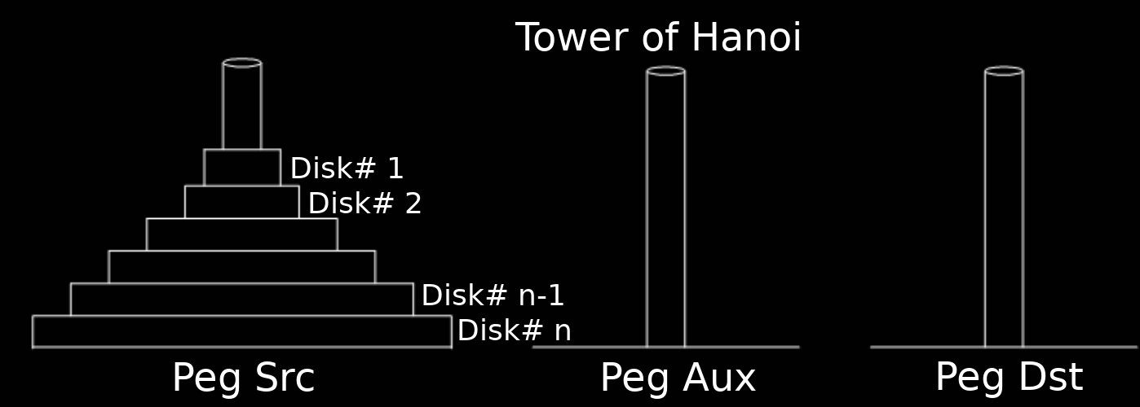
Tower of Hanoi problem: Move n disks from the source (S) peg to the destination (D) peg using an auxiliary (A) peg. Initially, all the n disks are stacked on the source peg in the descending order from bottom to top. Moving exactly one disk from the top of a peg to the top of another peg is the only kind of legal moves. A disk cannot be placed on top of a larger disk.

Slide 39
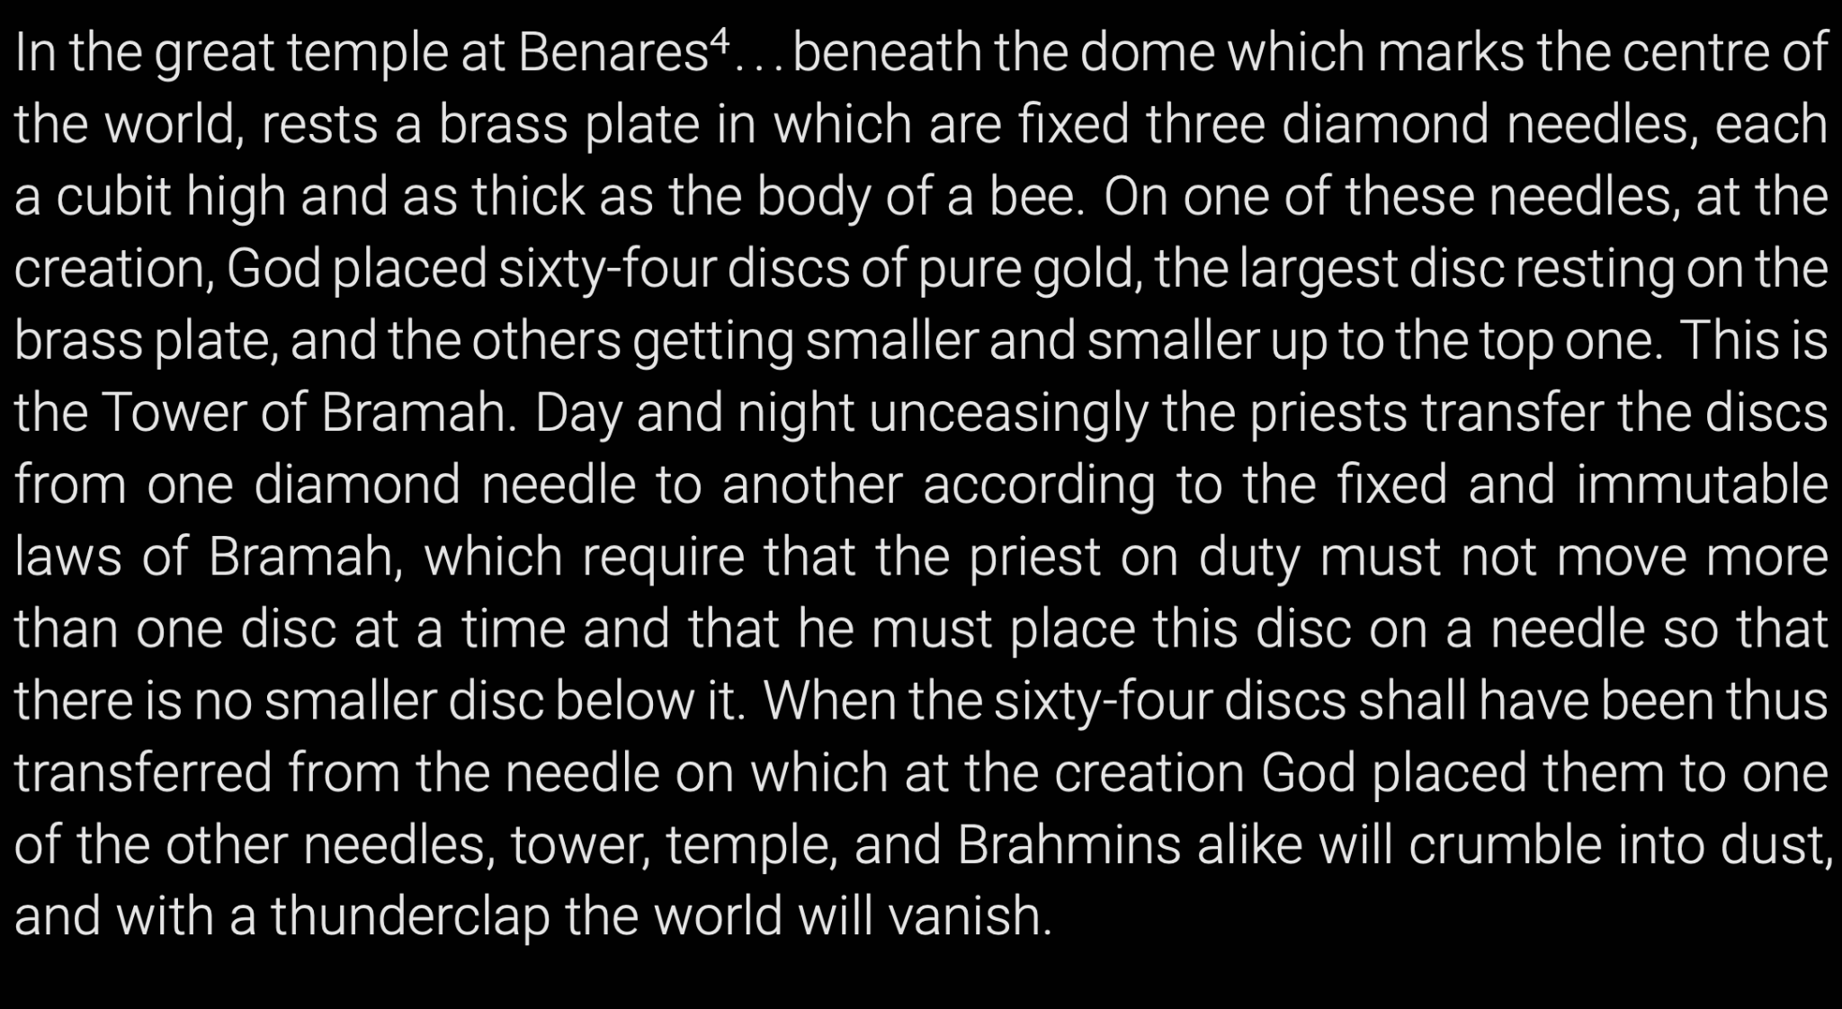

Slide 40
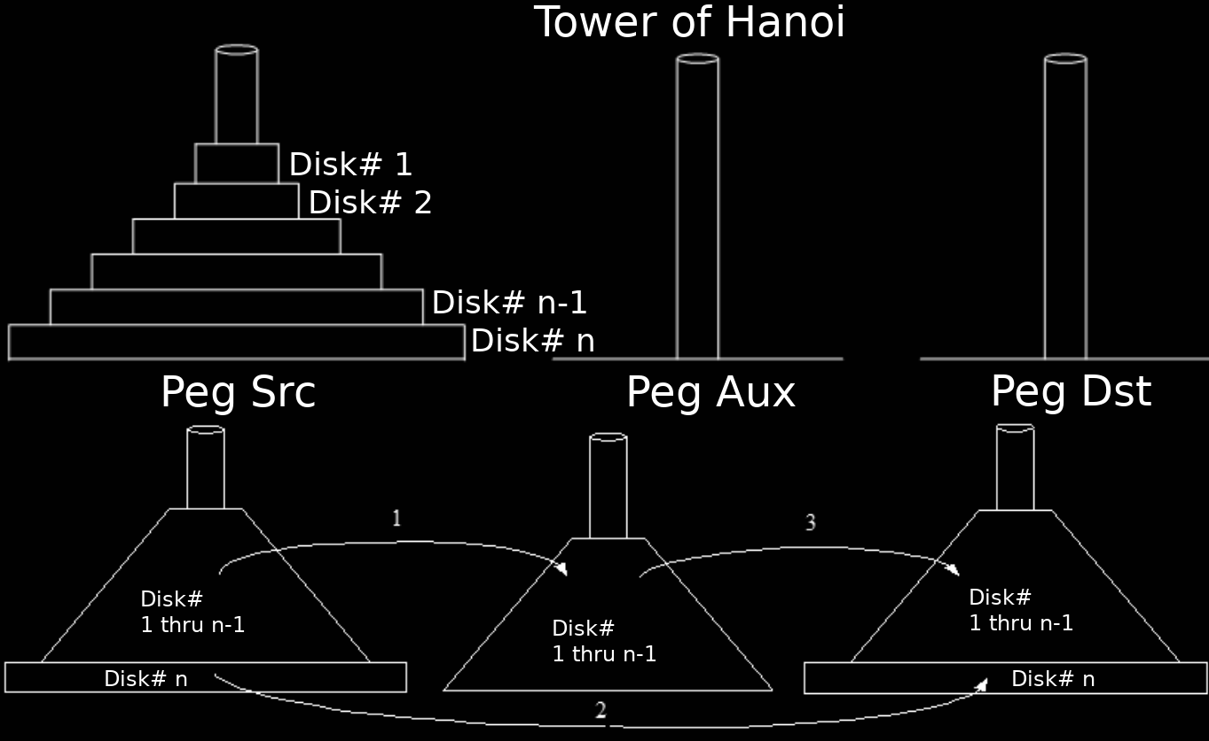

Slide 41
Tower of Hanoi
Algorithm Hanoi(n, Src, Dest, Aux) // n ≥ 0, from Src to Dest
if(n=0) return
Hanoi(n-1, Src, Aux, Dest) // from Src to Aux
Move disk# n from Src to Dest
Hanoi(n-1, Aux, Dest, Src) // from Aux to Dest
return
Proof of correctness: ?
Time Complexity T(n) = ?
Number of disk moves: C(n) = ?

Slide 42
Tower of Hanoi
Algorithm Hanoi(n, Src, Dest, Aux) // n ≥ 0, from Src to Dest
if(n=0) return
Hanoi(n-1, Src, Aux, Dest) // from Src to Aux
Move disk# n from Src to Dest
Hanoi(n-1, Aux, Dest, Src) // from Aux to Dest
return
Proof of correctness: Math induction
Time Complexity T(n) = T(n-1) + 1 + T(n-1), T(0) = 1.
Number of disk moves: C(n) = C(n-1) + 1 + C(n-1), C(0) = 0.

Slide 43
Tower of Hanoi
T(n) = 2 T(n - 1) + 1, T(0) = 1
= 2 * [2 T(n - 2) + 1] + 1
= 4 * T(n - 2) + 2 + 1
= 4 * [2 T(n - 3) + 1] + 2 + 1
= 2³ T(n - 3) + 2² + 2¹ + 2⁰
= 2^{i} * T(n - i) + 2^{i-1} + 2^{i-2} … + 2⁰
T(n - i) is going to be T(0) when n -i = 0 ⇒ i = n
T(n) = 2^{n} * T(0) + 2^{i-1} + 2^{i-2} … + 2⁰
= 2^{n} + 2^{n} - 1 ∈ Θ(2^{n})

Slide 44
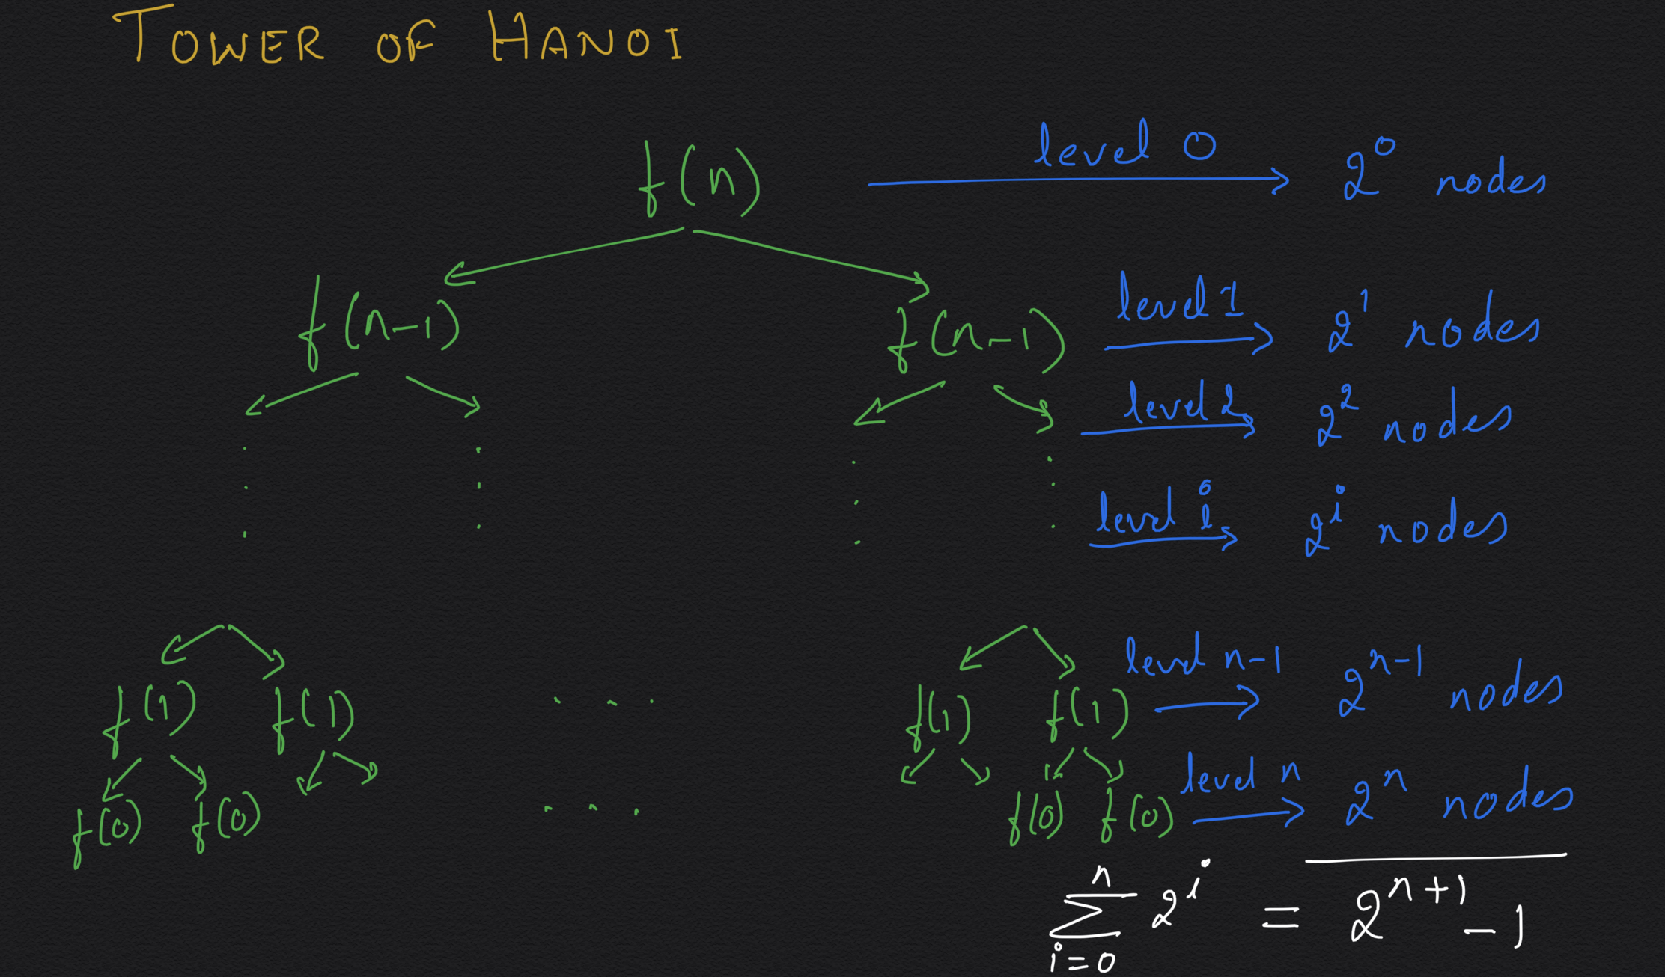

Slide 45
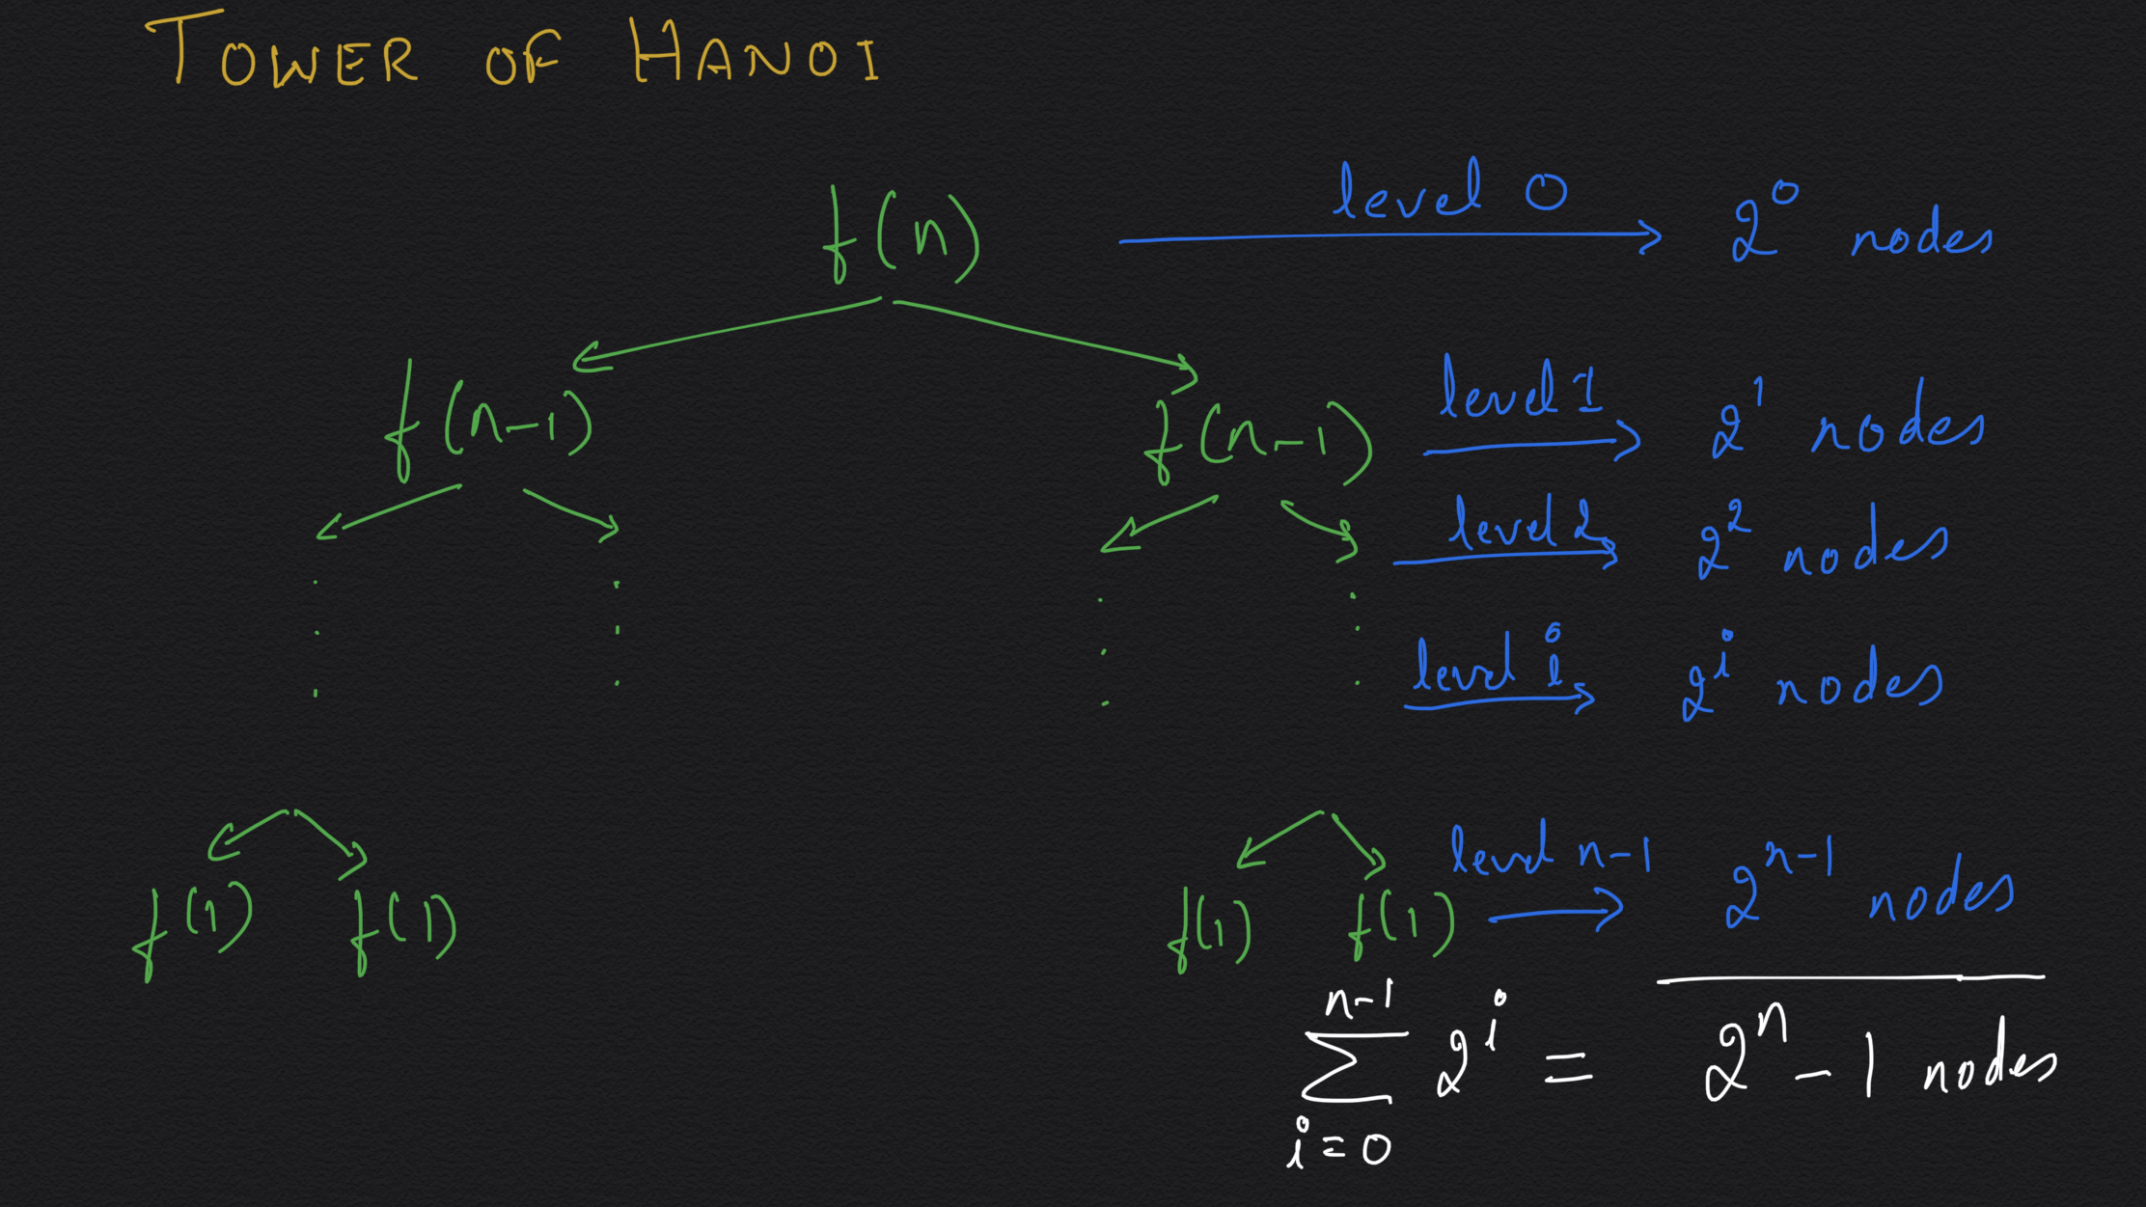

Slide 46
Tower of Hanoi with Tail Recursion optimization
Algorithm Hanoi(n, Src, Dest, Aux) // n ≥ 0, from Src to Dest
while(true)
if(n=0) return
Hanoi(n-1, Src, Aux, Dest) // from Src to Aux
Move disk# n from Src to Dest
// Hanoi(n-1, Aux, Dest, Src) // from Aux to Dest
n = n-1
Swap(Src, Aux)
return

Slide 47
You are climbing a staircase. It takes n steps to reach the top. Each time you can either climb 1 or 2 steps. In how many distinct ways can you climb to the top?
F(n) = …

Slide 48
Strong Induction:
To prove that predicate P(n) is true for all positive integers n we complete two steps:
Basis Step: We verify that P(1) is true.
Inductive Step: We show that the conditional statement (P(1)∧ P(2) ∧ · · · ∧ P(k)) → P(k+1) is true for all positive integers k ≥ 1.
That is, ( P(1) ∧ ∀k (P(1) ∧···∧ P(k) → P(k+1)) ) → ∀nP(n) is a tautology.
Proof: Using mathematical induction.

Slide 49
You are climbing a staircase. It takes n steps to reach the top. Each time you can either climb 1 or 2 steps. In how many distinct ways can you climb to the top?
F(n) = F(n-1) + F(n-2), F(1) = 1, F(2) = 2.
Algorithm F(n) // n ≥ 0
if(n <= 2) return n
return F(n-1) + F(n-2)
T(n) = ?

Slide 50
Finding n^{th} number in the Fibonacci sequence
F(n) = F(n-1) + F(n-2), F(1) = 1, F(2) = 2.
Algorithm F(n) // n ≥ 0
if(n <= 2) return n
return F(n-1) + F(n-2)
T(n) = T(n-1) + T(n-2) + 1, and T(0) = T(1) = 1.

Slide 51
Finding n^{th} number in the Fibonacci sequence
F(n) = F(n-1) + F(n-2), F(1) = 1, F(2) = 2.
Algorithm F(n) // n ≥ 0
if(n <= 2) return n
return F(n-1) + F(n-2)
T(n) = T(n-1) + T(n-2) + 1, and T(0) = T(1) = 1.
T(n) = Θ(ɸ^{n}), where ɸ = (1 + √5) / 2
≅ 1.62, the golden ratio

Slide 52
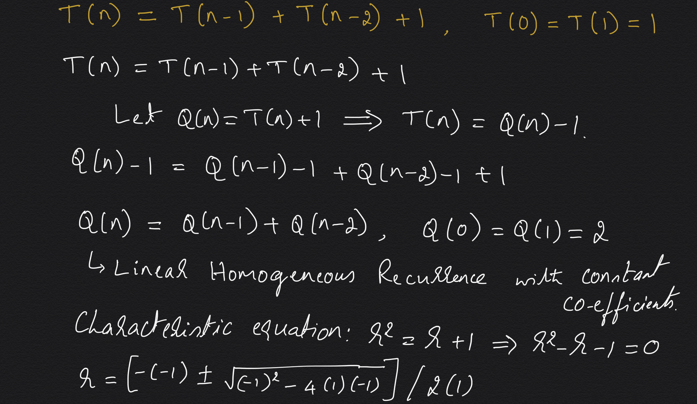

Slide 53
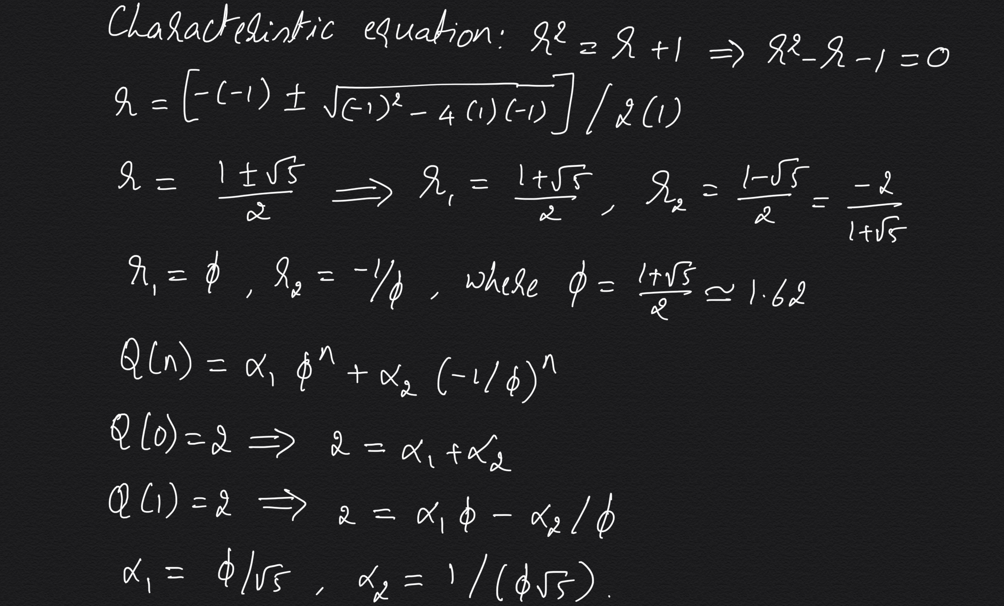

Slide 54
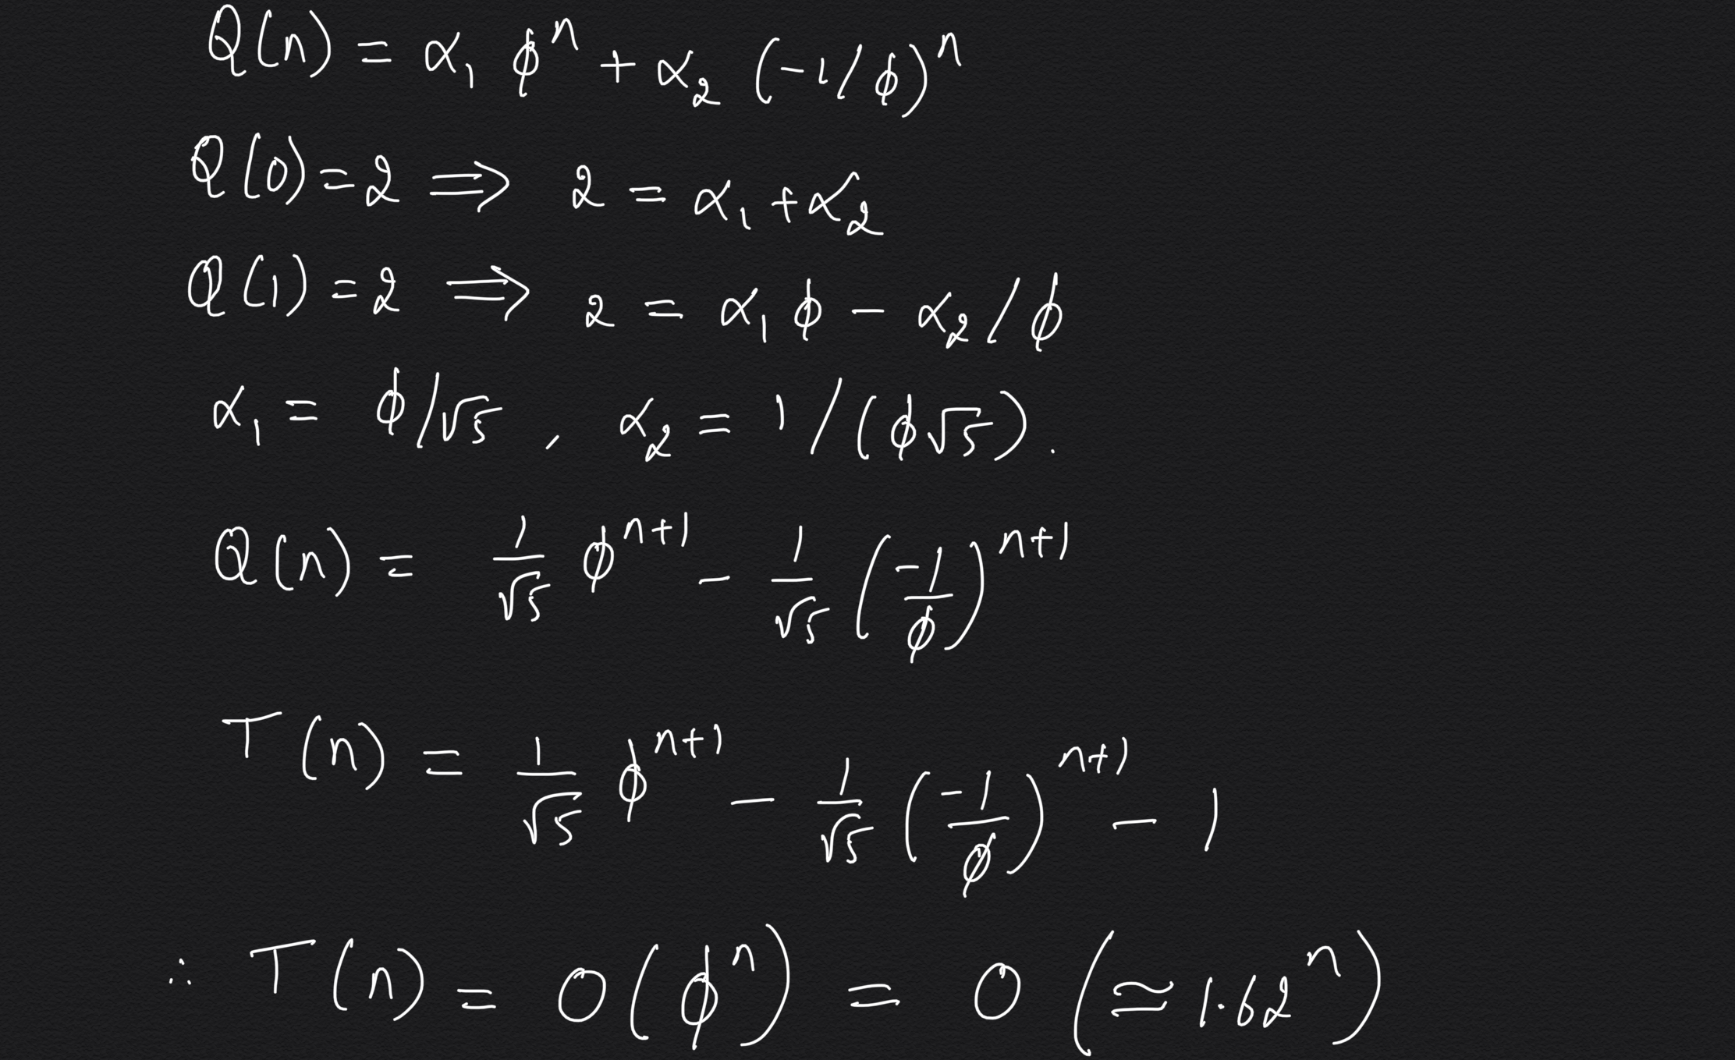

Slide 55
Algorithm F(n) // n ≥ 0
if(n <= 2) return n
return F(n-1) + F(n-2)
T(n) = Θ(ɸ^{n}), where ɸ = (1 + √5) / 2
Algorithm F(n) // n ≥ 0
if(n <= 2) return n
prev = 1, cur = 2
for i = 3 to n
nxt = prev + cur
prev = cur, cur = nxt
return cur
T(n) = Θ(n)

Slide 56
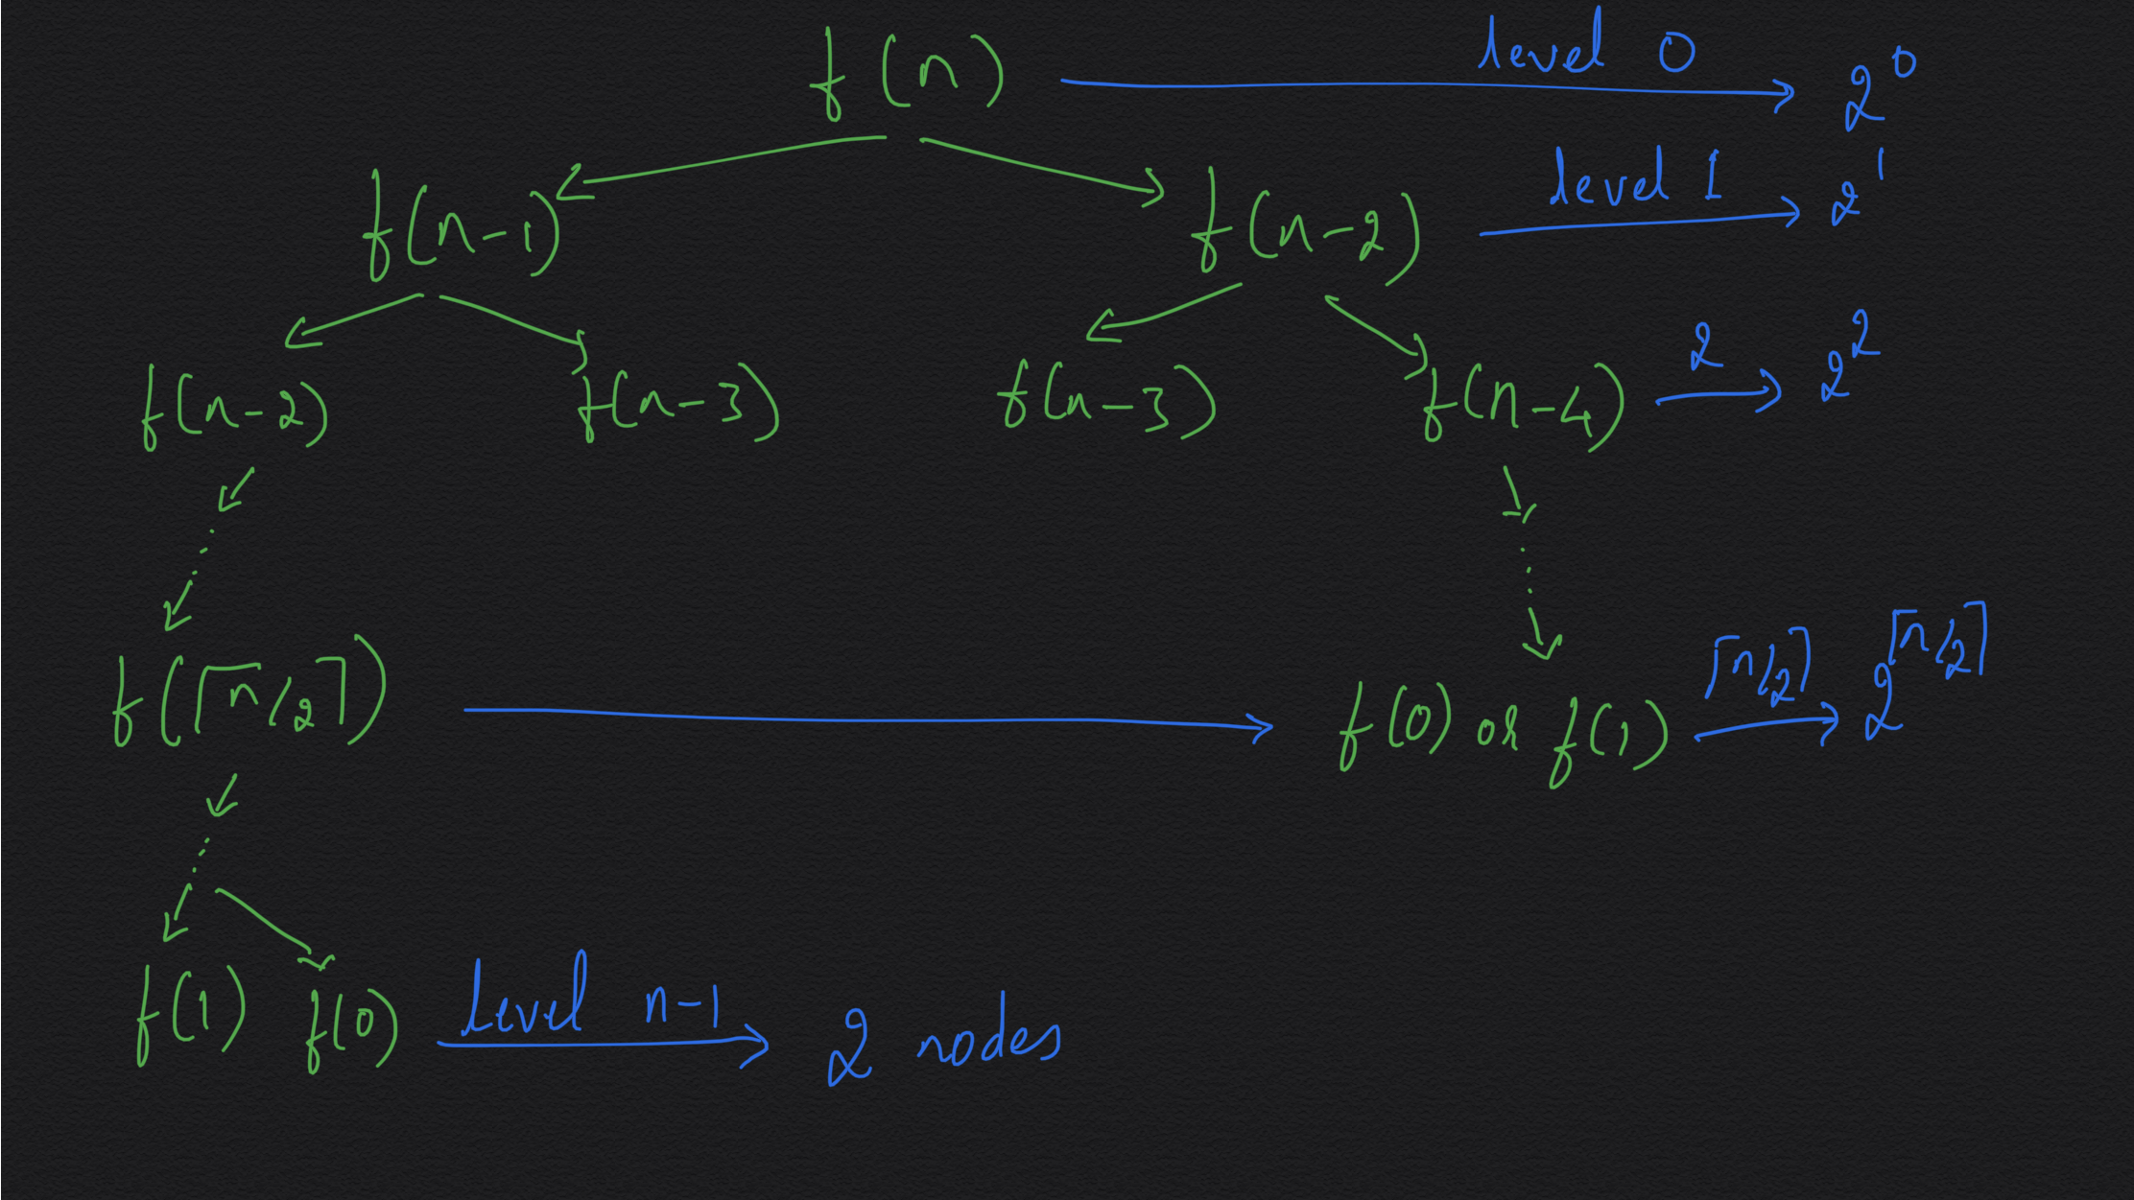

Slide 57
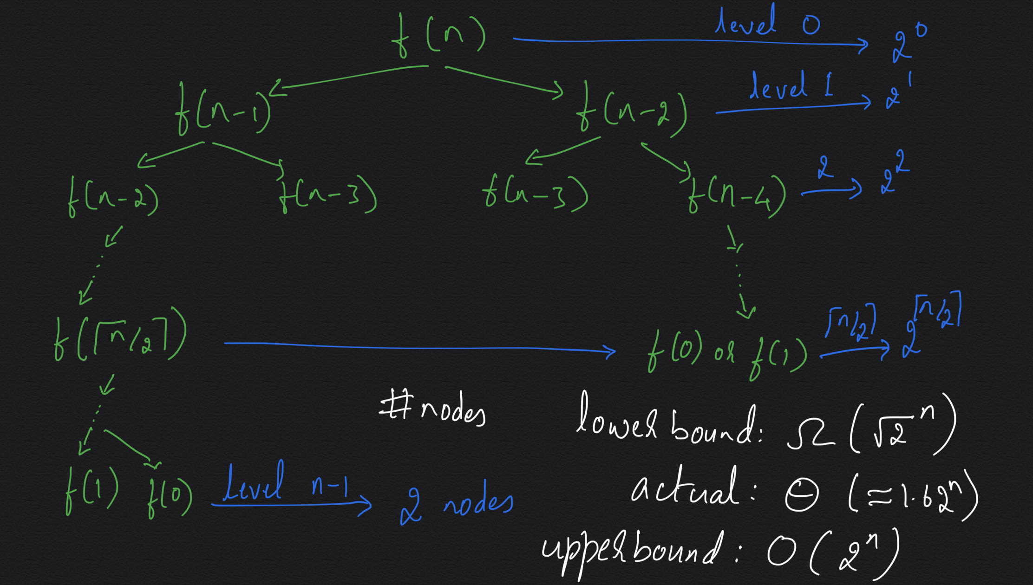

Slide 58
Divide-and-Conquer
Solve(problem)
Divide the problem into subproblems
For each subproblem
Solve(subproblem)
Integrate the solution of subproblems
Problem:
Sort A[0..n-1] using divide-and-conquer

Slide 59
Mergesort
//Call with mergesort(A, 0, n) to sort an array A[0..n-1]
Algorithm mergesort(A, low, high) // [low, high)
if(high-low ≤ 1) return // basis step
mid = low + (high-low)/2 // divide
mergesort(A, low, mid) // solve subproblems
mergesort(A, mid, high)
merge(A, low, mid, high) // integrate
return
T(n) = T(⌊n/2⌋) + T(⌈n/2⌉) + cn
= 2T(n/2) + cn = Θ(n logn).

Slide 60
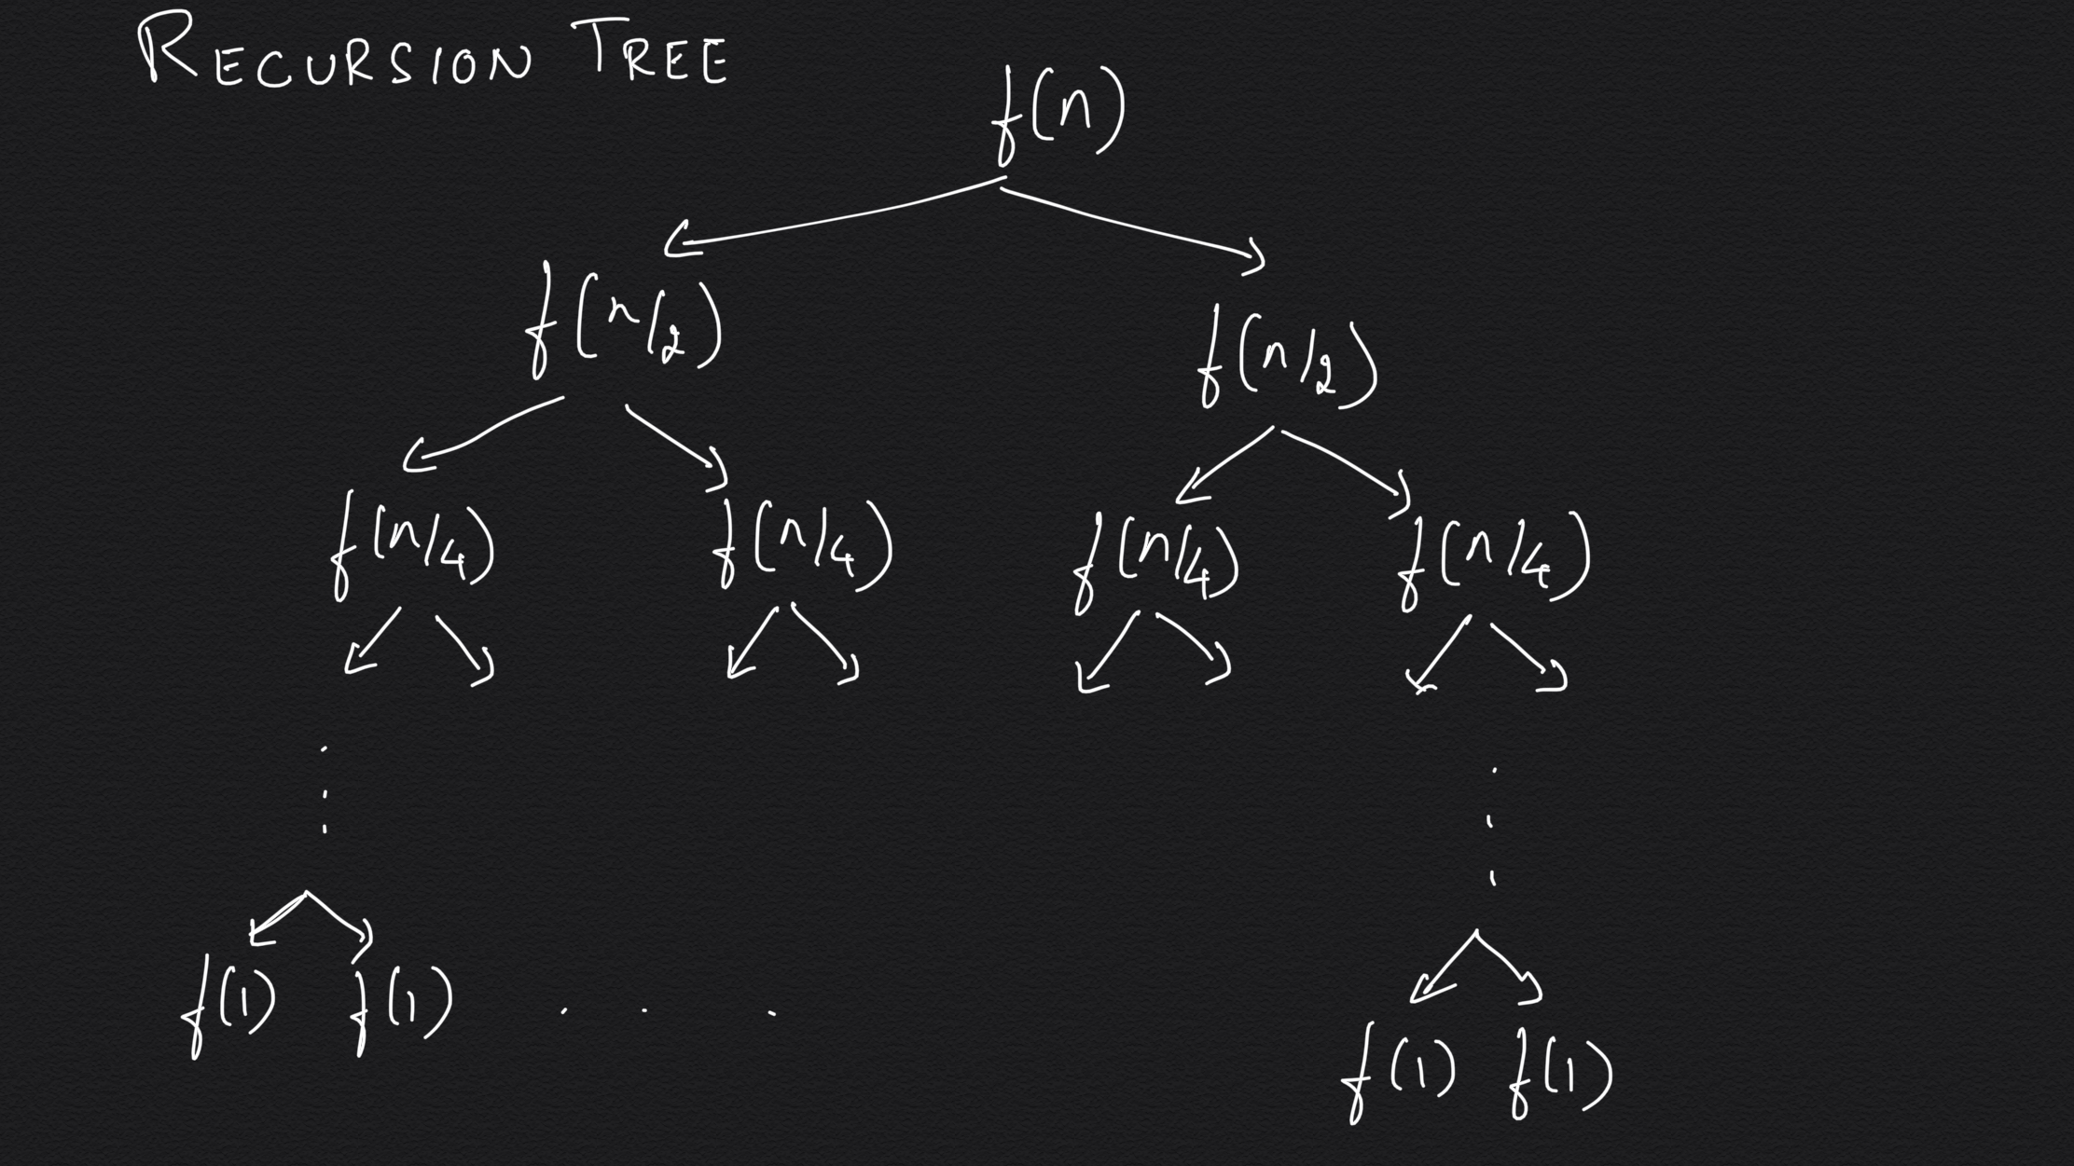

Slide 61
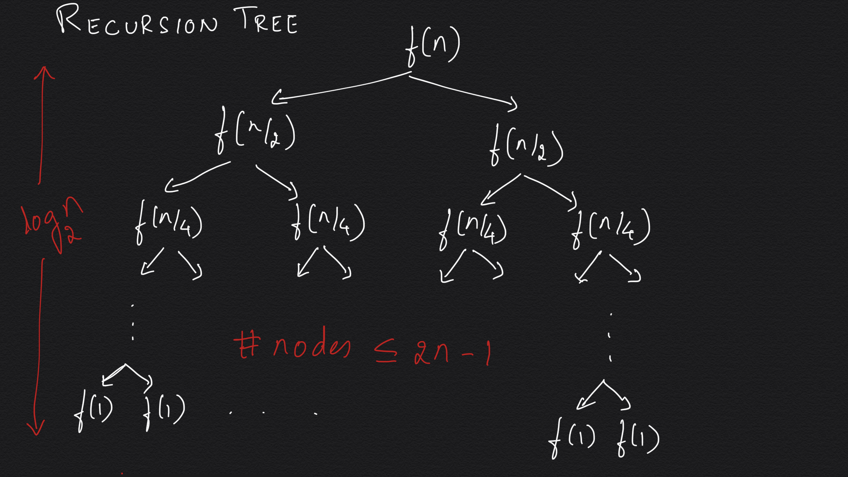

Slide 62
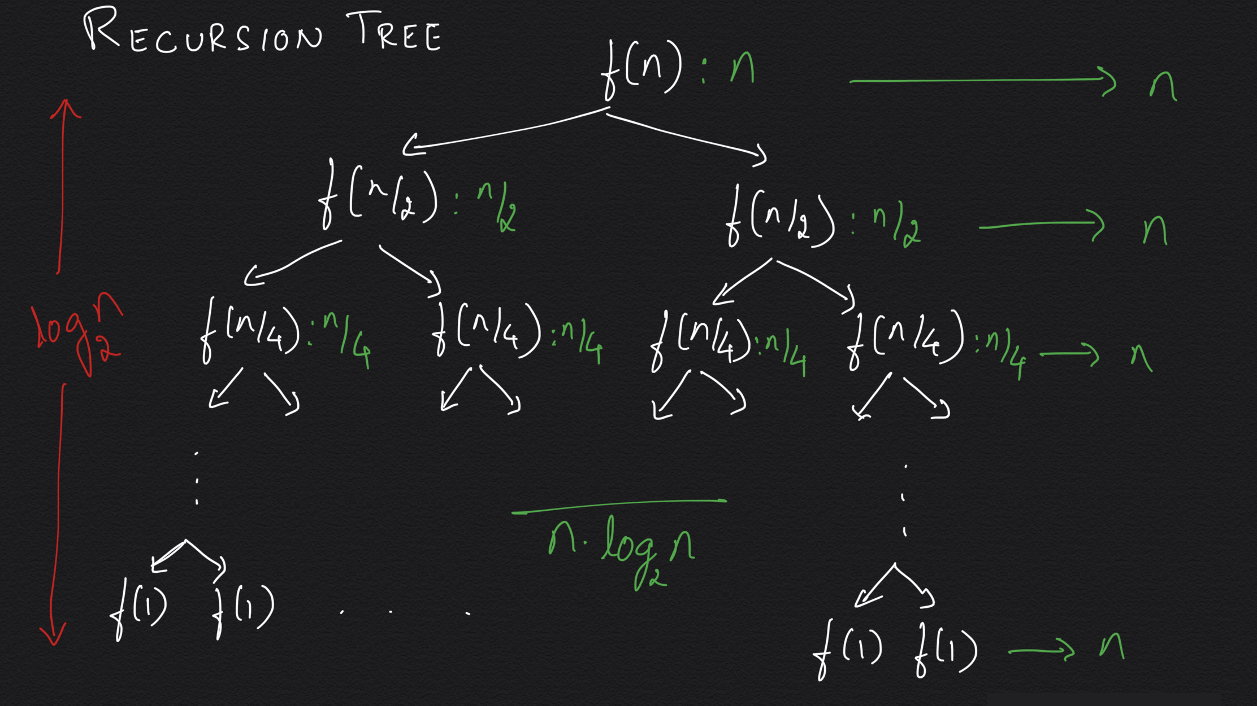

Slide 63
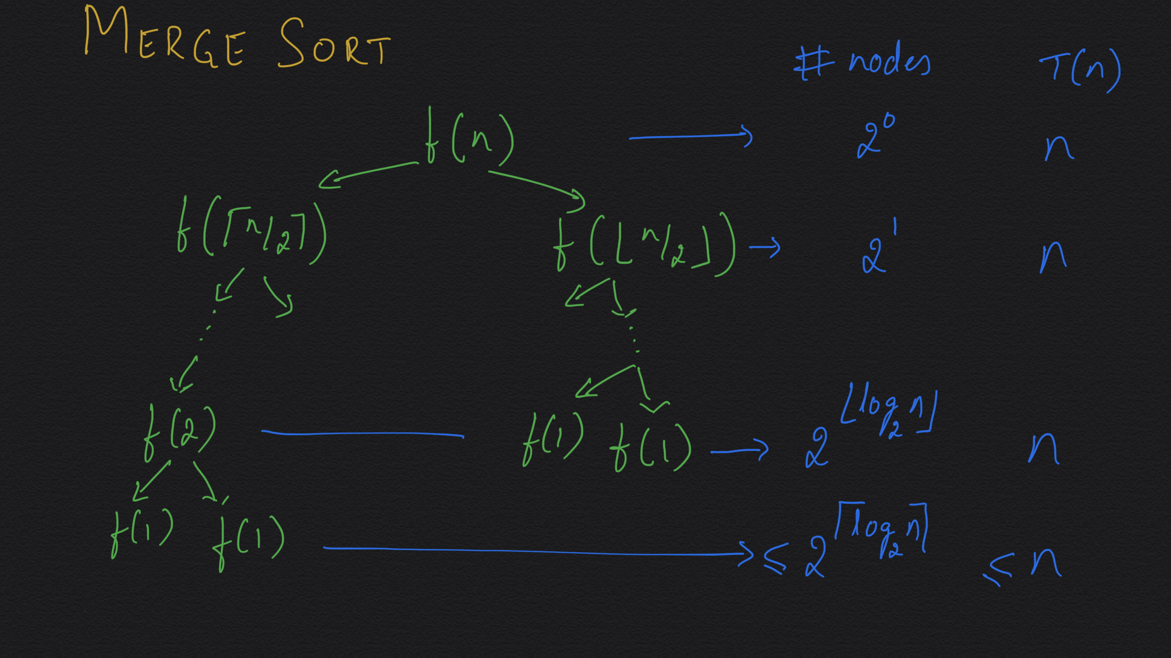

Slide 64
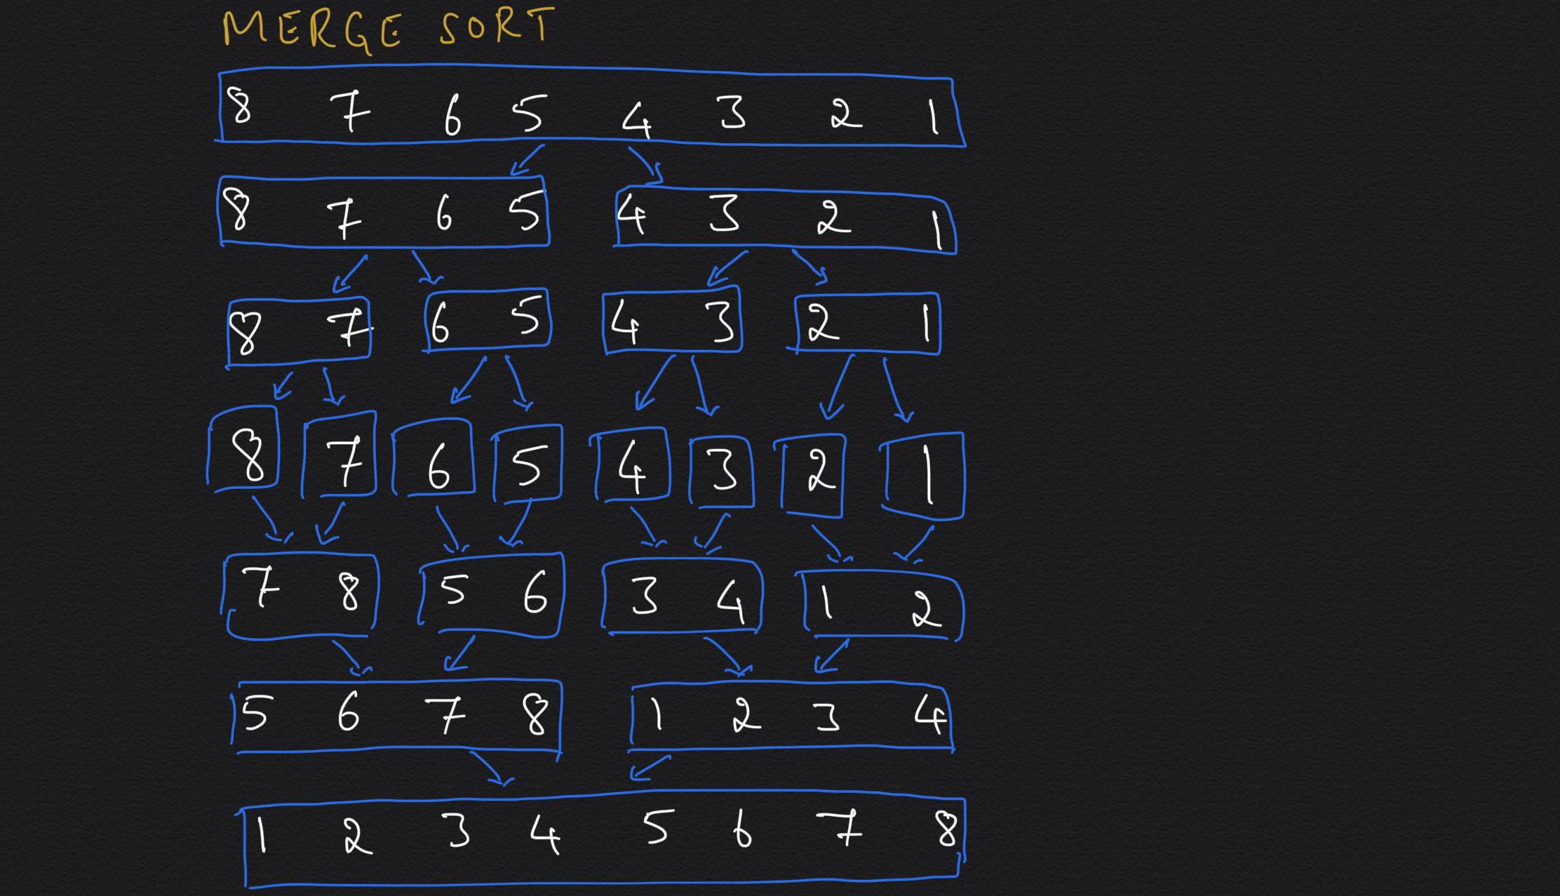

Slide 65
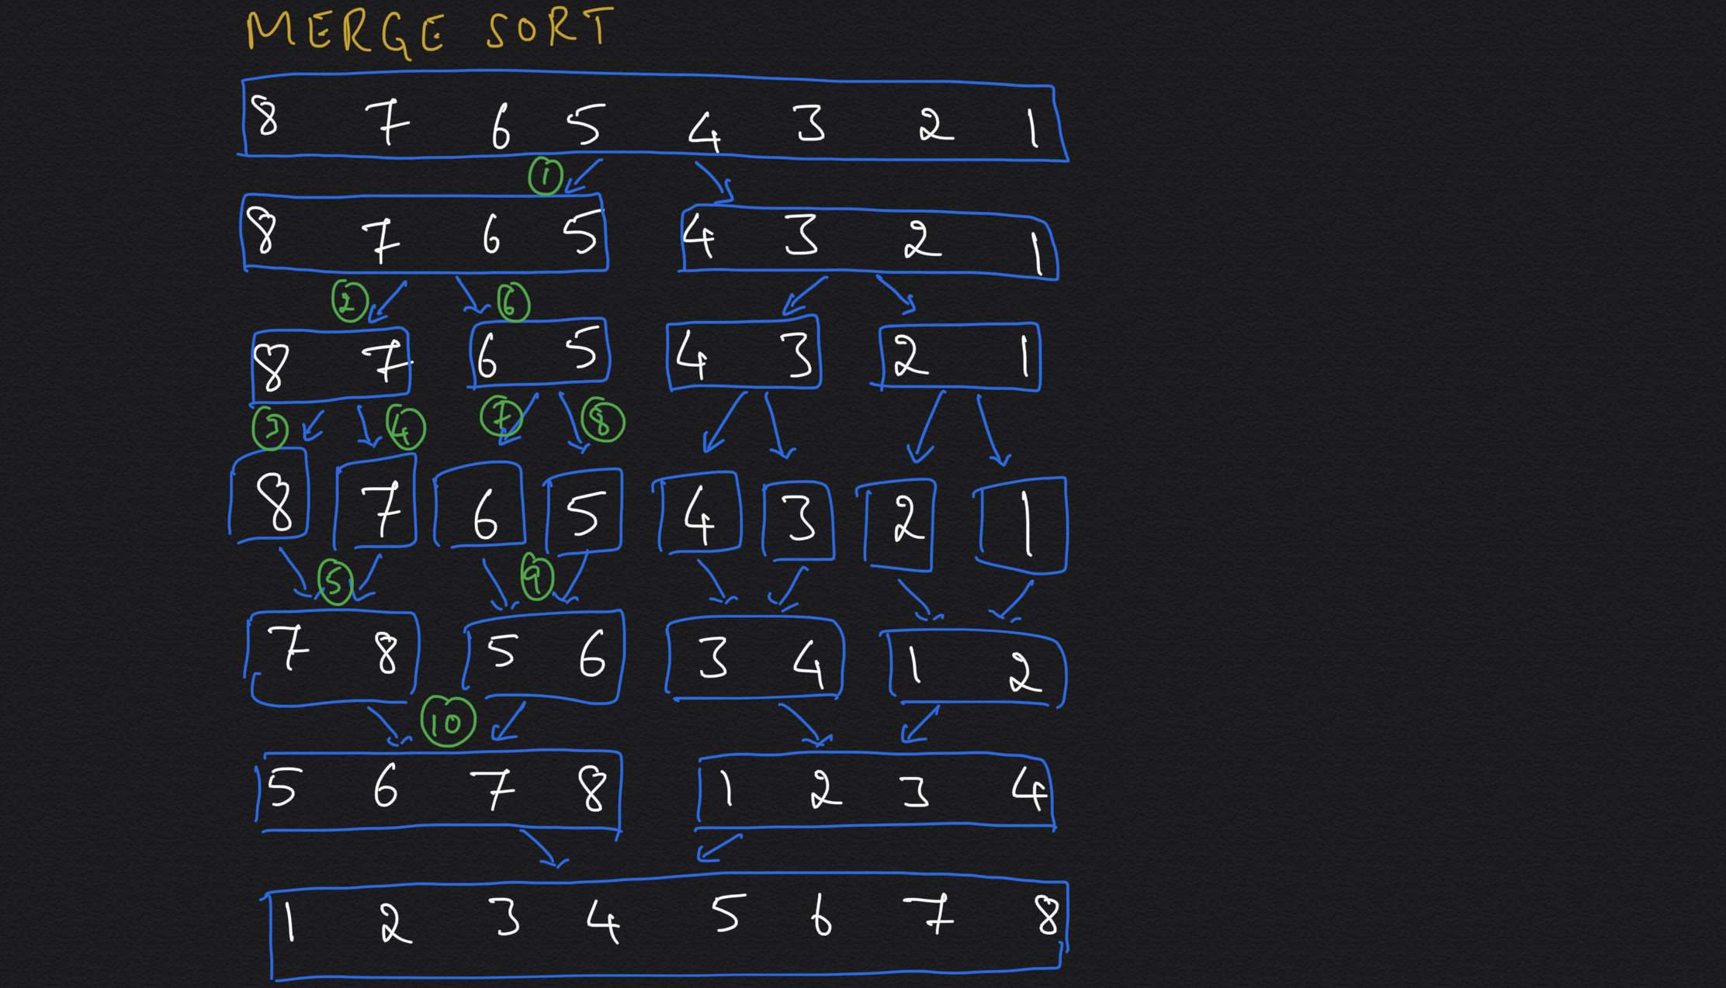

Slide 66
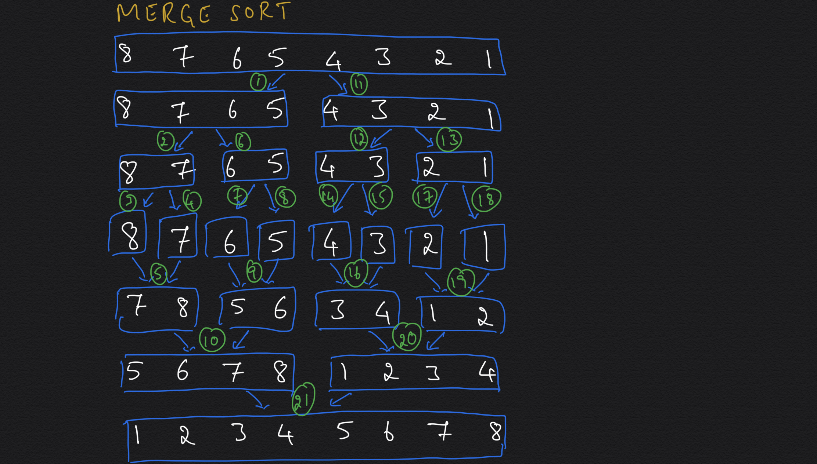

Slide 67
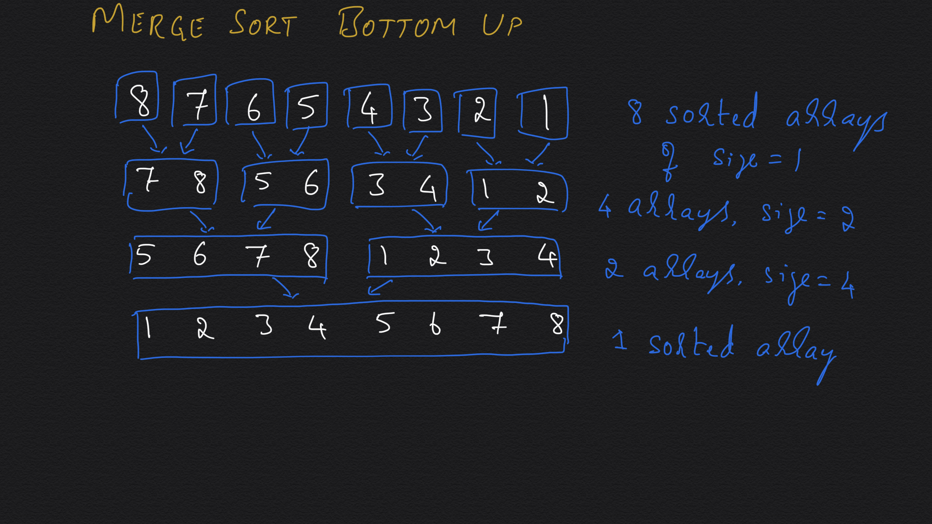

Slide 68
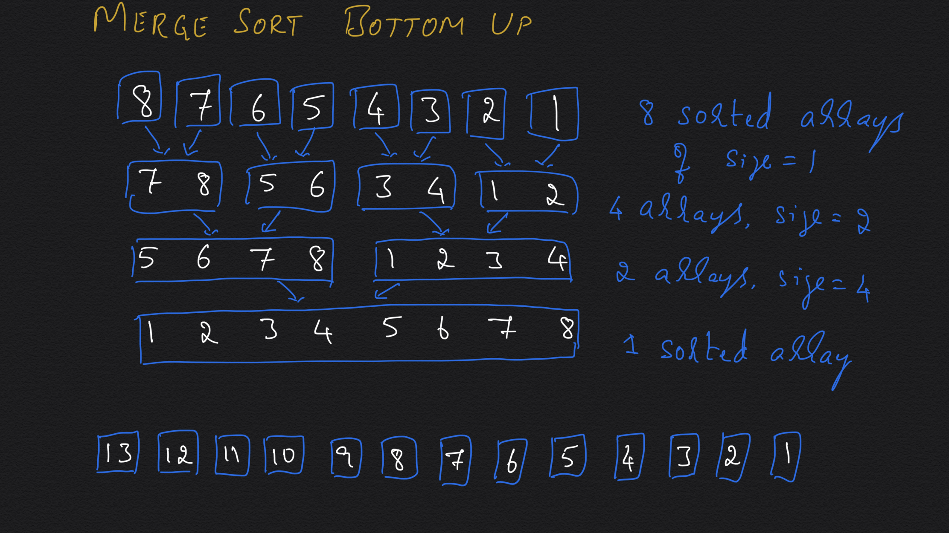

Slide 69
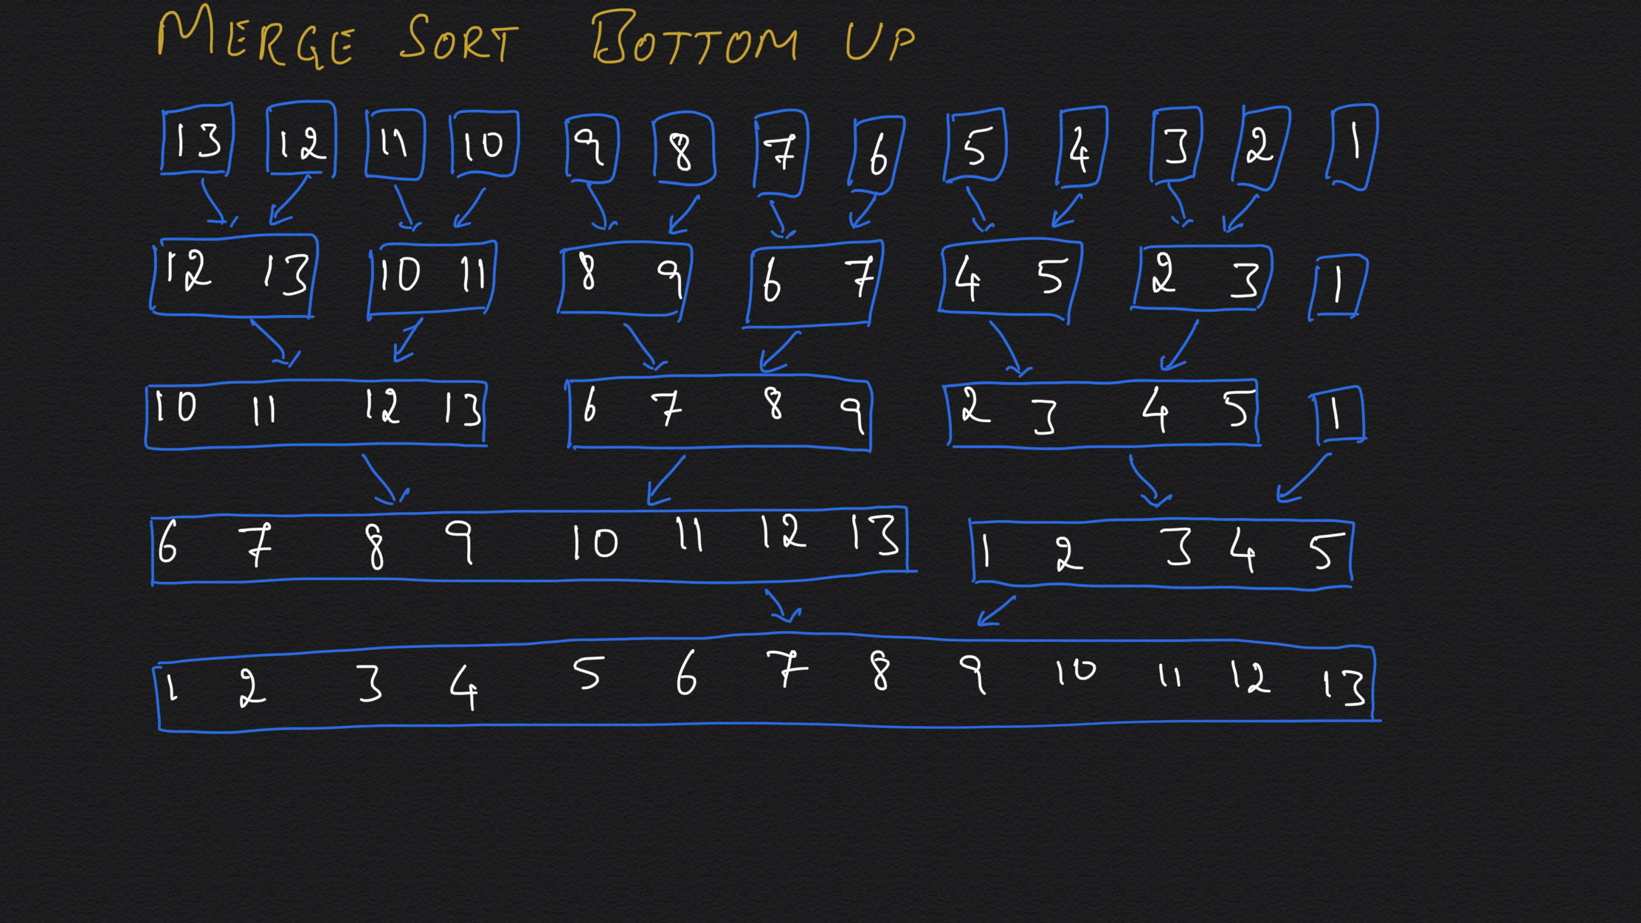

Slide 70
Quicksort
Algorithm quicksort(A, low, high)
if(high-low ≤ 1) return // basis step
mid ← Partition(A, low, high) // divide
quicksort(A, low, mid - 1) // solve subproblems
quicksort(A, mid + 1, high)
// there is nothing to integrate
return
T_{worst}(n) = O(n²).
T_{avg}(n) = O(n logn).

Slide 71
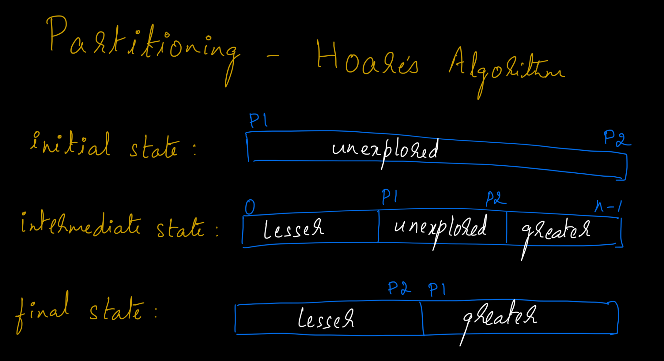

Slide 72
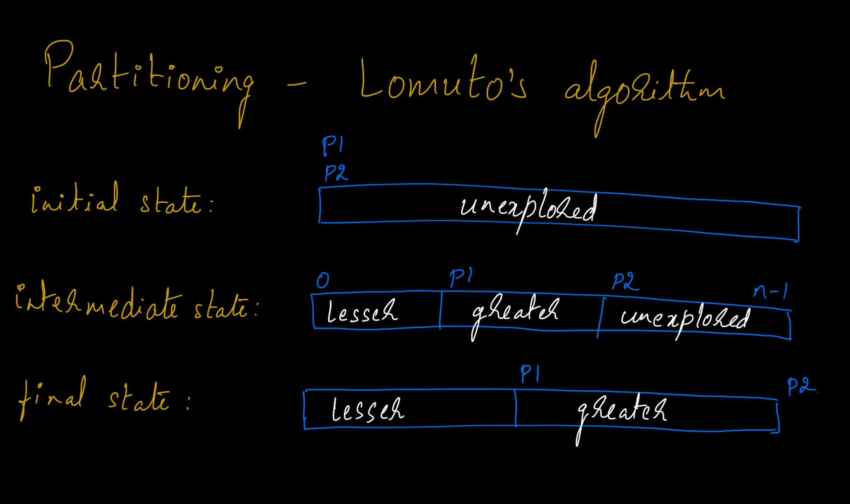

Slide 73
Quicksort
Algorithm quicksort(A, low, high)
while(true)
if(high-low ≤ 1) return // basis step
mid ← Partition(A, low, high) // divide
quicksort(A, low, mid - 1) // solve subproblems
// quicksort(A, mid + 1, high)
low = mid + 1
return
T_{worst}(n) = O(n²).
T_{avg}(n) = O(n logn).

Slide 74
Problem: Find the kth largest element in an unsorted array. Note that it is the kth largest element in the sorted order, not the kth distinct element.
Input: [3,2,3,1,2,4,6,5,6] and k = 3
Output: 5
Hint: Divide-n-Conquer

Slide 75
Problem: Nuts and Bolts
There are n pairs of nuts and bolts, each pair with a different diameter. Each nut matches exactly one bolt, and each bolt matches exactly one nut. All the nuts are in a bowl and all the bolts are in a different bowl. Find an efficient way a way of matching each nut with the corresponding bolt. You cannot compare a nut with another nut, or a bolt with another bolt. You can compare a nut with a bolt that has three possible outcomes; -1 if the nut is smaller than the bolt, 0 if the nut matches with the bolt, and +1 if the nut is bigger than the bolt.
Hint: Divide-n-Conquer

Slide 76
Nuts_n_Bolts
Algorithm NB( N[1..n], B[1..n] ) //n > 0
if(n = 1) return <N[1], B[1]> // basis step
<Bset1, k, Bset2> = PartitionOnN(N, B, N[1]) //divide
<Nset1, k, Nset2> = PartitionOnB(N, B, B[k])
pairs1 = NB(Nset1[1..k-1], Bset1[1..k-1]) //solve
pairs2 = NB(Nset2[k+1..n], Bset2[k+1..n]) //subproblems
return { pairs1, <N[k], B[k]>, pairs2 }
T_{worst}(n) = O(n²). T_{best}(n) = O(n logn). T_{avg}(n) = O(n logn).

Slide 77
Problem: Max Contiguous Sum (Max Subarray)
Given a non-empty array of n integers, find the maximum sum of non-empty subarray.
Eg: [2, -6, -1, 3, -1, 2, -2]
Max sum = 4
Eg: [−2, 1, −3, 4, -1, 2, 1, −5, 4]
Max sum = 6

Slide 78
Problem: Max Contiguous Sum (Max Subarray)
indices: [0] [1] [2] [3] [4] [5] [6] Array: 2, -6, -1, 3, -1, 2, -2 Sum from arr[0]: 2, -4, -5, -2, -3, -1, -3 Sum from arr[1]: -6, -7, -4, -5, -3, -5 Sum from arr[2]: -1, 2, 1, 3, 1 Sum from arr[3]: 3, 2, 4, 2 Sum from arr[4]: -1, 1, -1 Sum from arr[5]: 2, 0 Sum from arr[6]: -2

Slide 79
Solution: Brute Force / Exhaustive Search
maxsum( arr[0..n-1] )
maxsofar = 0 for i = [0, n) for j = [i, n) sum = 0 for k = [i, j] sum = sum + arr[k] // sum[i .. j] maxsofar = max(maxsofar, sum)
return maxsofar
Time Complexity T(n) = O(n³)
Space Complexity S(n) = O(1)

Slide 80
Solution: Improved Brute-Force/Exhaustive-Search
maxsum( arr[0..n-1] )
maxsofar = 0 for i = [0, n) sum = 0 for j = [i, n) sum = sum + arr[j] // sum[i .. j] maxsofar = max(maxsofar, sum)
return maxsofar
Time Complexity T(n) = O(n²)
Space Complexity S(n) = O(1)

Slide 81
maxsum: Divide and Conquer
Example: 2 5 -15 1 3 | -2 7 4 -1 Max on left (recursion): 2 5 Max on right(recursion): 7 4 Mid extend to left: 1 3 Mid extend to right: -2 7 4 Possible candidates: 7 (2+5), 11 (7+4), 13 (1+3-2+7+4) Overall maximum: 13

Slide 82
maxsum: Divide and Conquer
maxsum(arr, l, u) { // Call with maxsum(arr, 0, n-1) if (l > u) return 0 // zero elements if (l == u) return max(0, arr[l]) // one element m = (l + u) / 2 // find max crossing to left lmax = sum = 0 for (i = m; i >= l; i--) sum = sum + arr[i] lmax = max(lmax, sum) // find max crossing to right rmax = sum = 0 for i = (m, u] sum = sum + arr[i] rmax = max(rmax, sum) return max(lmax+rmax, maxsum(arr,l,m), maxsum(arr,m+1,u))

Slide 83
maxsum: Divide and Conquer
Time Complexity can be found by the following recurrence relation:
T(n) = O(n) + 2T(n/2), T(1) = 1.
T(n) = n + 2T(n/2)
= n + 2( n/2 + 2T(n/4) )
= 2n + 4( n/4 + 2T(n/8) ) = 3n + 2³*T(n/2³)
= i*n + 2^{i}*T(n/2^{i})
T(n/2^{i}) becomes T(1) when n/2^{i} = 1
⇒ n = 2^{i} ⇒ i = log(n)
T(n) = n log(n) + n * T(1) = O(n log(n))
At any point, the stack depth is of O(log(n)), and hence S(n) = O(log(n))
Why? HINT: Consider the tree of recursive calls and calculate the depth of this tree.

Slide 84
Thank You :-)

